Slide 1
EE140: Introduction to Programming Concepts for Engineers
Lecture 1b: Introduction to Unix OS

Slide 2
What is Unix?
Unix is an operating system, like Windows.
Designed and developed in the late 1960s and 70s at Bell Labs to allow scientists to store, share and manipulate data, exchange ideas and work collaboratively.
This was before personal computers or the Web
The Unix OS can run multiple applications simultaneously (multitasking); it supports multiple users at the same time (multiuser)
“Shells” (bash, csh, ksh, …) allow users to communicate with the unix kernel.

Slide 3
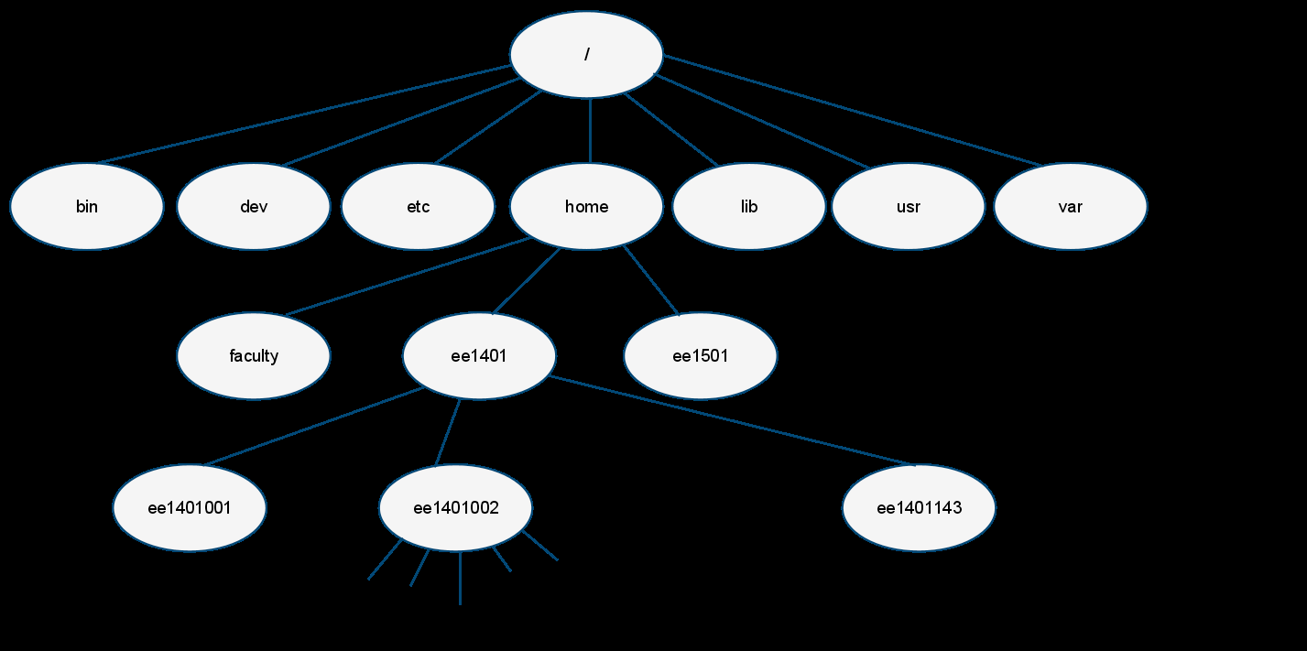
Unix File System
All elements under Unix are either files (directories are special files) or processes
File system is hierarchical

Slide 4
Student Accounts
(hand out IDs)
Use the program “putty” to log on
System you are logging on to is:
aclinux.montgomerycollege.edu
putty gives you a login window to the unix machine
Starting password is “student”
You can download putty to your home computer

Slide 5
Your Unix account on aclinux
Change your password using the passwd command in Unix
You may use psftp to transfer files between your account and your local machine
See:
http://www.montgomerycollege.edu/~aakmal/programming_links.html
to download putty to your home machine.

Slide 6
Unix commands
Unix commands are used to interact with the shell
Commands are a keyword which may or may not have “switches”
Commands may or may not take arguments
eg:
unix prompt> ls (list files)
unix prompt> ls -l (list files, long format)
unix prompt> ls –l directory (list contents of directory in long format)
unix prompt> ls –l directory/*.out (list contents of directory in long format that end with suffix “.out”)

Slide 7
Useful Unix Commands
ls list files (default)
ls -a list all files (including invisibles)
ls -l list files (long format)
ls –al list files (all of them, long format)
mkdir directory create a new directory (empty)
cd directory go down one level to directory
cd ~ (or just cd) go to home directory (from wherever)
cd .. go up one directory in the hierarchy
cd ../.. go up two directories in the hierarchy
passwd change your password

Slide 8
More Useful Unix Commands
rm remove a file (delete it)
rm –r recursive remove (directory)
rmdir remove an empty directory
mv file1 file2 rename (or move) file1 to file2
cp file1 file2 copy file1 to file2
more view contents of a file one page at a time
chmod change file permissions
pwd present working directory (where am I?)
man command online manual page for command
exit exit (logout) from session

Slide 9
Unix command line tips
shell command history is accessible via up/down arrows
command and filename completion is accessible via tab key
All unix commands will accept wildcards (“*”). eg:
ls *.c lists all files in current directory that end “.c”
rm *.* removes all files in current directory

Slide 10
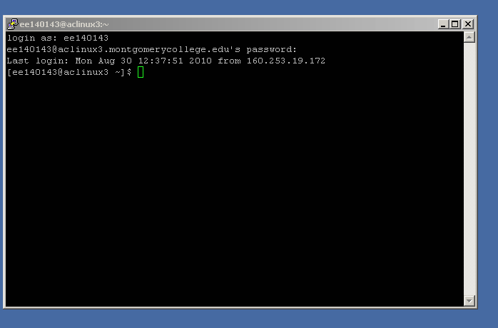
Step 1: Design and Create
Log onto aclinux3

Slide 11
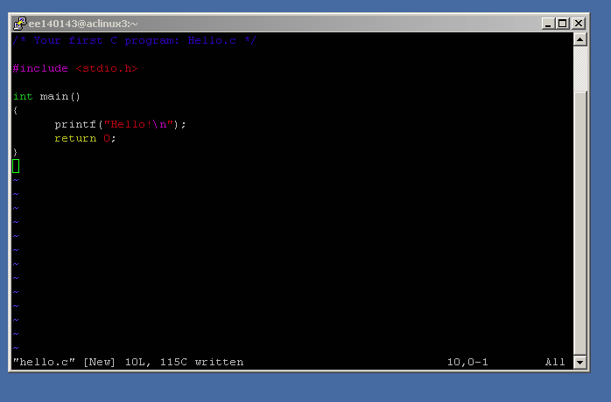
Step 1: Design and Create
Type in code:

Slide 12
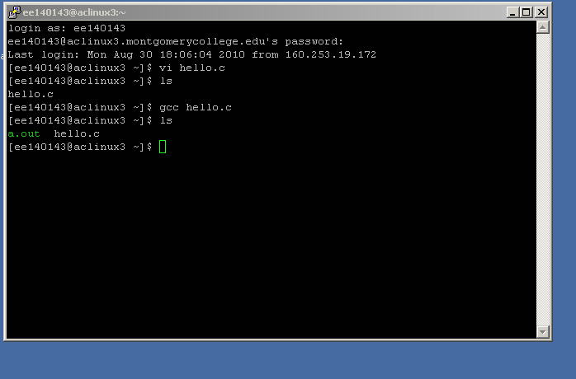
Step 2: Compile the Program

Slide 13
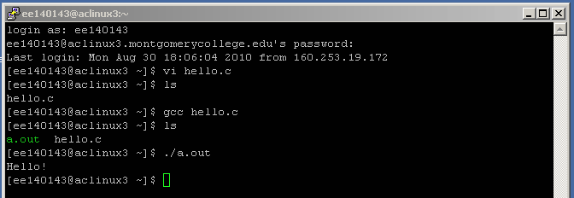
Step 3: Execute, test, and debug
To execute your program type path to executable (./a.out)
Test your program on sample data if input is needed
Go back to Step 1 if there are problems

Slide 14
Submitting your assignments
$>mkdir assignment_1 make a directory
$>cd assignment_1 move to directory
(put source and compiled code in this directory: question1.c, question1.out, etc …)
$>cd .. move back up one directory
$>tar –czvf assignment_1.tar.gz assignment_1
create a compressed archive
$>cp assignment_1.tar.gz /home/faculty/dkuijt/dropbox/ee140
leave assignment in my dropbox

Slide 15
Hello.c
/* Your first C program: Hello.c */
#include <stdio.h>
int main()
{
printf( "Hello!\n");
return 0;
}

